Slide 1
Embargoed for 10:45 a.m. ET, 11-17-19
Efficacy and safety of dapagliflozin in HFrEF according to age: insights from DAPA-HF
Felipe Martinez
Professor of Medicine, Cordoba National University
Director, Damic Institute-Rusculleda Foundation
Past President, Argentina Federation of Cardiology and
International Society of CV Pharmacotherapy

Slide 2
Disclosure
Dr Martinez reports personal fees from AstraZeneca during the conduct of the study.
And has received research grants/honoraria from BMS, Cardiorentis,Lilly, Milestone, Novartis, Pfizer,Sanofi,Servier,Takeda,Vifor,

Slide 3
Background (1)
In many countries, the number of elderly patients with heart failure (HF) is increasing.
In other geographic regions (such as Latin America, Africa and Asia), people with HF are often younger than those in North America and Western Europe.
Therefore, it is very important to understand the efficacy and safety of new treatments in all age groups.

Slide 4
Background (2)
Tolerability is a particular concern in the elderly, not only because of advanced age and comorbidity, but also because of polypharmacy.
The benefit of therapy may also be questioned in the elderly.
We examined the efficacy and safety of dapagliflozin according to age in a post hoc analysis of DAPA-HF, a placebo-controlled trial in which dapagliflozin was added to other guideline-recommended therapies in patients with HF and reduced ejection fraction (HFrEF).

Slide 5
DAPA-HF Design
Enrolment
Randomization
Inclusion:
NYHA class II-IV
LVEF ≤40%
NT-proBNP ≥600 pg/ml*
Exclusion:
eGFR <30 ml/min/1.73 m²
SBP <95 mmHg
type 1 diabetes
N=2371
Placebo
≥844 Primary endpoints
Composite of:
CV death
HF hospitalization
Urgent HF visit
Dapagliflozin
10 mg once daily
N=2373
Visit 1
Visit 2
Visit 3
Visit 4
Visit 5
Visit 6 etc.
Day −14
Day 0
Day 14
Day 60
Day 120
Every 120 days
*≥400 pg/ml if HF hospitalization within ≤12 months; ≥900 pg/ml if atrial fibrillation/flutter

Slide 6
Statistical methods
Age considered as both a categorical (<55, 55–64, 65–74, ≥75 years) and continuous variable.
Time-to-event data analysed using Kaplan–Meier estimates and Cox proportional-hazards models.
A semiparametric proportional-rates model (LWYY) used to calculate total (including recurrent) events.
A fractional polynomial was constructed with age and entered into the model as an interaction term with treatment.
The interaction between age & treatment for the pre-specified safety outcomes was tested in a logistic regression model.

Slide 7
Results

Slide 8
Key baseline characteristics according to age
Median age 67 (range 22-94) years, 36% of patients were aged 66–75 years and 21% were >75 years
Characteristic | <55 years (n=636) | 55–64 years (n=1242) | 65–74 years (n=1717) | ≥75 years (n=1149) | P for trend
Age, years | 47 | 60 | 69 | 79 | -
Female, n (%) | 19 | 21 | 24 | 28 | <0.001
Atrial fibrillation n (%) | 19 | 32 | 42 | 51 | <0.001
Prior MI, n (%) | 31 | 43 | 49 | 46 | <0.001
Hypertension, n (%) | 54 | 70 | 79 | 83 | <0.001
Type 2 diabetes, n (%) | 34 | 45 | 44 | 39 | 0.50
eGFR, mL/min/1.73 m² | 83 | 72 | 62 | 56 | <0.001
eGFR <60 mL/min/1.73 m², n (%) | 14 | 27 | 46 | 62 | <0.001
SBP, mmHg | 118 | 121 | 123 | 123 | <0.001
Data are mean or n (%); eGFR, estimated glomerular filtration rate; MI, myocardial infarction; SBP, systolic blood pressure.

Slide 9
Heart failure characteristics according to age
Variable | <55 years (n=636) | 55–64 years (n=1242) | 65–74 years (n=1717) | ≥75 years (n=1149) | P for trend
Ischemic etiology, n (%) | 41 | 53 | 61 | 61 | <0.001
NYHA class, n (%) |  |  |  |  | 0.018
II | 70 | 69 | 67 | 65
III | 29 | 30 | 32 | 34
IV | 1.6 | 1.1 | 0.6 | 0.7
KCCQ-TSS (score out of 100) | 76 | 75 | 79 | 79 | <0.001
Prior HF hospitalization, n (%) | 50 | 48 | 48 | 45 | 0.042
Ejection fraction, % | 29 | 31 | 31 | 32 | <0.001
NTproBNP, pg/mL | 1107 | 1332 | 1453 | 1737 | <0.001
Data are mean KCCQ and NT-proBNP median) or n (%); HF, heart failure; NTproBNP, N-terminal pro B-type natriuretic peptide; KCCQ-TSS, Kansas City Cardiomyopathy Questionnaire –Total Symptom Score; NYHA, New York Heart Association

Slide 10
Baseline treatment according to age
Treatment | <55 years (n=636) | 55−64 years (n=1242) | 65−74 years (n=1717) | ≥75 years (n=1149) | P for trend
ACE inhibitor | 62 | 58 | 56 | 51 | <0.001
ARB | 23 | 26 | 28 | 32 | <0.001
ARNI | 11 | 11 | 11 | 10 | 0.37
Diuretic | 96 | 95 | 93 | 91 | <0.001
Digitalis | 23 | 20 | 18 | 16 | <0.001
Beta-blocker | 98 | 98 | 96 | 94 | <0.001
MRA | 83 | 76 | 69 | 62 | <0.001
ICD or CRT-D | 21 | 27 | 30 | 23 | 0.51
CRT-P/CRT-D | 4 | 7 | 8 | 9 | <0.001
Data are n (%); ACE, angiotensin-converting enzyme; ARB, angiotensin receptor blocker; ARNI, angiotensin receptor-neprilysin inhibitor; CRT, Cardiac Resynchronization Therapy, D, Defibrillator; ICD, Implantable Cardioverter-Defibrillator; MRA, mineralocorticoid receptor antagonist; P, Pacemaker.

Slide 11
Efficacy outcomes

Slide 12
Overall: Primary composite outcome
CV Death/HF hospitalization/Urgent HF visit
HR 0.74 (0.65, 0.85)
p=0.00001
NNT=21
Placebo
Dapagliflozin
McMurray JJV et al N Engl J Med. 2019 Sep 19. doi:10.1056/NEJMoa1911303

Slide 13
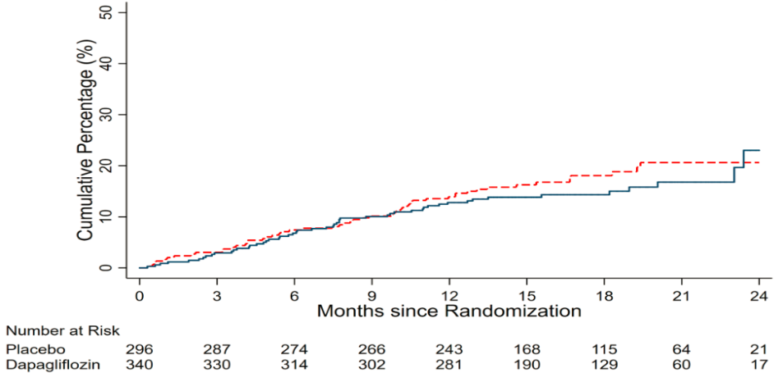
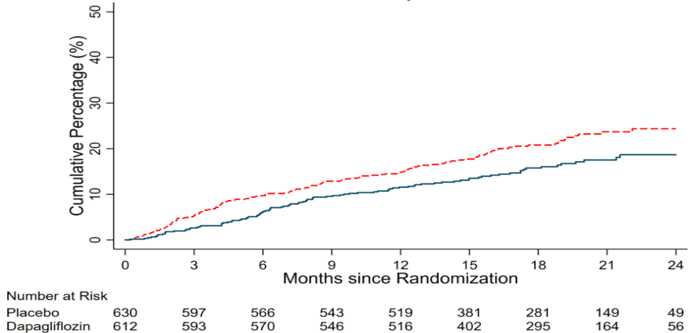
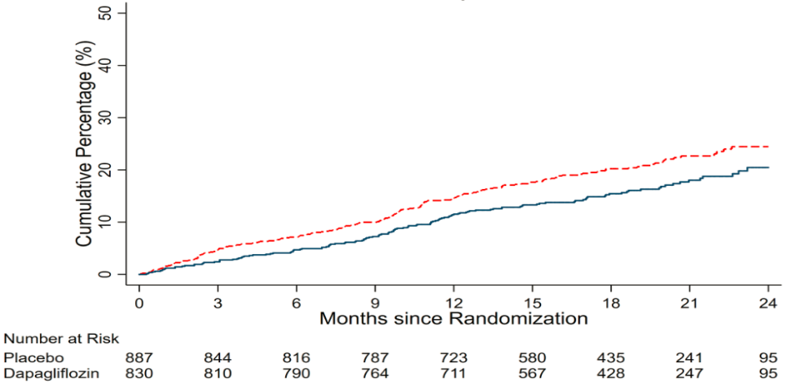
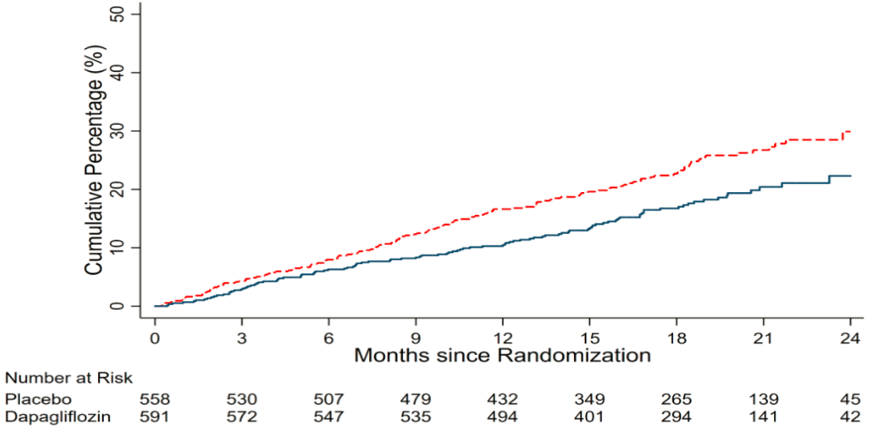
Primary outcome according to age
P interaction = 0.76
<55 years
55–64 years
HR 0.87 (0.60, 1.28)
HR 0.71 (0.55, 0.93)
65–74 years
≥75 years
HR 0.76 (0.61, 0.95)
HR 0.68 (0.53, 0.88)

Slide 14
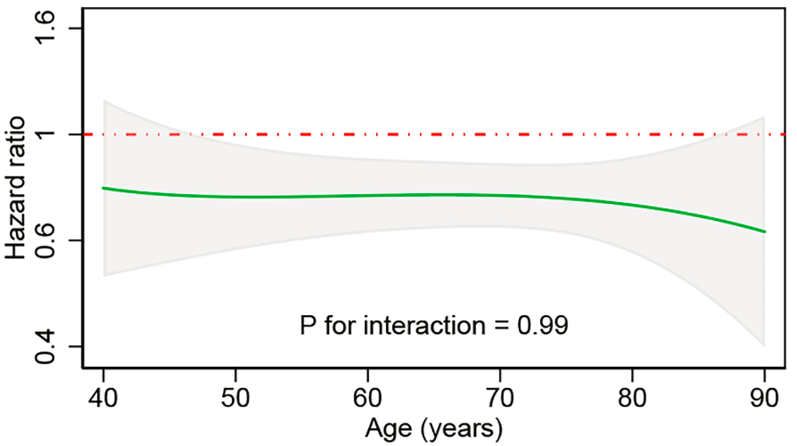
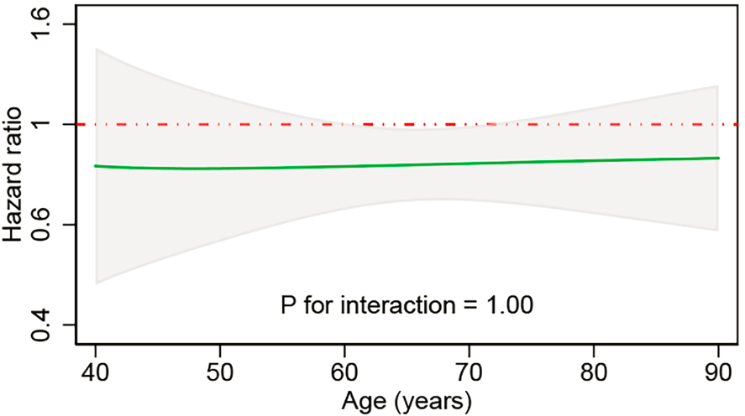
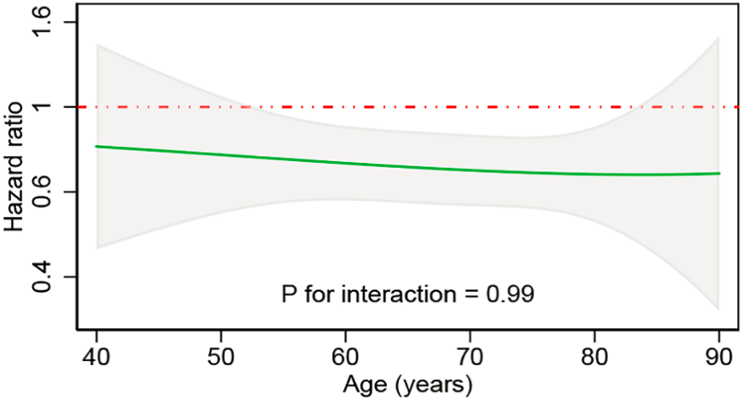
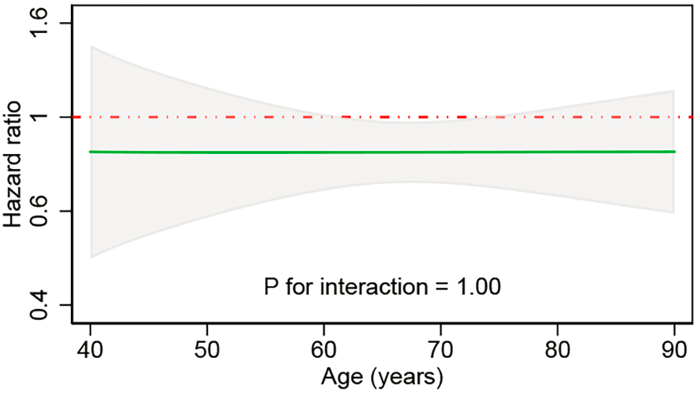
Outcomes according to age (continuous variable)
Unity (HR=1)
Continuous HR for dapagliflozin vs placebo
95% CI
Primary Outcome
CV Death
HF hospitalization/urgent visit
All-cause death

Slide 15
Clinically meaningful change (≥5 points) in KCCQ-TSS from baseline to 8 months
Improvement
Deterioration
Placebo
(N=2371)
Dapa 10 mg
(N=2373)
Placebo
(N=2371)
Dapa 10 mg
(N=2373)
Odds Ratio (95% CI)
Odds Ratio (95% CI)
<55 years
55−64 years
65−74 years
≥75 years
All
56.4%
59.5%
60.4%
55.2%
58.3%
1.07 (0.90,1.27)
1.13 (1.00,1.27)
1.21 (1.09,1.35)
1.15 (1.02,1.31)
1.15 (1.08,1.23)
<55 years
55−64 years
65−74 years
≥75 years
All
0.90 (0.74,1.09)
0.87 (0.76,1.00)
0.77 (0.69,0.86)
0.86 (0.75,0.99)
0.84 (0.78,0.90)
52.9%
53.3%
50.5%
48.0%
50.9%
30.2%
31.3%
34.2%
33.9%
32.9%
25.7%
25.7%
23.3%
27.6%
25.3%
0.6
0.8
1.0
1.2
1.4
0.6
0.8
1.0
1.2
1.4
Placebo better
Dapagliflozin better
Dapagliflozin better
Placebo better
CI = Confidence Interval, Dapa = Dapagliflozin

Slide 16
Tolerability and safety

Slide 17
Adverse events related to volume depletion according to age
 | <55 years (n=634) |  | 55–64 years (n=1240) |  | 65–74 years (n=1716) |  | ≥75 years (n=1146) |  | P value*
% of patients | Placebo (n=295) | Dapa (n=339) | Placebo (n=630) | Dapa (n=610) | Placebo (n=886) | Dapa (n=830) | Placebo (n=557) | Dapa (n=589)
Volume depletion | 5 | 7 | 6 | 6 | 6 | 7 | 10 | 11 | 0.86
Volume depletion (serious) | 1 | 0.3 | 2 | 0.8 | 1 | 2 | 3 | 1 | 0.15
*P-value is for interaction between age categories and treatment effect on the occurrence of adverse events; Data are n (%); Includes patients receiving at least one dose of study drug

Slide 18
Renal safety according to age
 | <55 years (n=634) |  | 55–64 years (n=1240) |  | 65–74 years (n=1716) |  | ≥75 years (n=1146) |  | P value*
% of patients | Placebo (n=295) |  | Placebo (n=630) |  | Placebo (n=886) |  | Placebo (n=557)
Renal AE | 4 |  | 5 |  | 8 |  | 11
Serious renal AE | 1 |  | 1 |  | 3 |  | 5
Doubling of serum creatinine | 2 |  | 3 |  | 3 |  | 5
 |  | Dapa (n=339) |  | Dapa (n=610) |  | Dapa (n=830) |  | Dapa (n=589)
 |  | 4 |  | 8 |  | 6 |  | 7 | 0.031
 |  | 0.9 |  | 2 |  | 2 |  | 0.5 | 0.002
 |  | 2 |  | 2 |  | 2 |  | 0.7 | 0.011
*P-value is for interaction between age categories and treatment effect on the occurrence of adverse events; Data are n (%); Includes patients receiving at least one dose of study drug

Slide 19
Treatment reduction/discontinuation and serious AEs according to age
 | <55 years (n=634) |  | 55–64 years (n=1240) |  | 65–74 years (n=1716) |  | ≥75 years (n=1146) |  | P value*
% of patients | Placebo (n=295) | Dapa (n=339) | Placebo (n=630) | Dapa (n=610) | Placebo (n=886) | Dapa (n=830) | Placebo (n=557) | Dapa (n=589)
AE → permanent treatment discontin. | 3 | 3 | 4 | 4 | 6 | 5 | 6 | 6 | 0.93
Any serious AE (including death) | 34 | 33 | 40 | 35 | 41 | 38 | 49 | 43 | 0.61
Any discontin. of study treatment | 8 | 11 | 9 | 8 | 12 | 11 | 14 | 12 | 0.38
*P-value is for interaction between age categories and treatment effect on the occurrence of adverse events; Data are n (%); Includes patients receiving at least one dose of study drug; Discontin., discontinuation

Slide 20
Summary and conclusions
Dapagliflozin reduced the risk of worsening HF events and CV death, and improved symptoms, in patients with HFrEF, when added to standard therapy. These benefits were consistent across the range of ages studied.
The relative and absolute risk reductions in death and hospitalization were substantial and clinically important. The absolute benefits in older patients were large because they were at higher risk than younger patients.
Dapagliflozin was well tolerated, and the rate of treatment discontinuation was low, in all age groups.
Dapagliflozin offers a new approach to the treatment of HFrEF, irrespective of age.

Slide 21
Circulation. 2019; [published online ahead of print]. DOI: 10.1161/CIRCULATIONAHA.119.044133
Efficacy and safety of dapagliflozin in HFrEF according to age: insights from DAPA-HF
Felipe A. Martinez, MD; Matteo Serenelli, MD; Jose C. Nicolau, MD, PhD; Mark C. Petrie, MBChB; Chern-En Chiang, MD, PhD; Sergey Tereshchenko, PhD; Scott D. Solomon, MD; Silvio E. Inzucchi, MD; Lars Køber, MD, DMSc; Mikhail N. Kosiborod, MD; Piotr Ponikowski, MD, PhD; Marc S. Sabatine, MD, MPH; David L. DeMets, PhD; Monika Dutkiewicz-Piasecka MD; Olof Bengtsson Ph. Lic; Mikaela Sjöstrand, MD, PhD; Anna Maria Langkilde, MD, PhD; Pardeep Jhund, MD PhD; John JV McMurray, MD
Circulation
https://www.ahajournals.org/doi/10.1161/CIRCULATIONAHA.119.044133

Slide 22
THANKS

